Slide 1
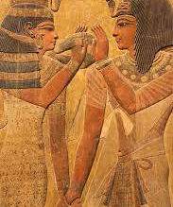
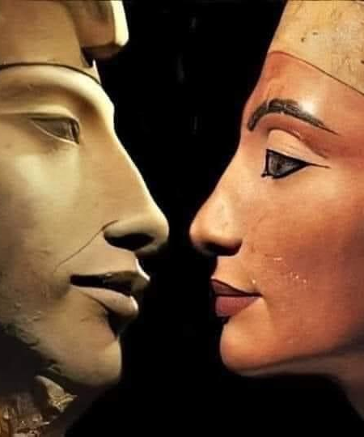
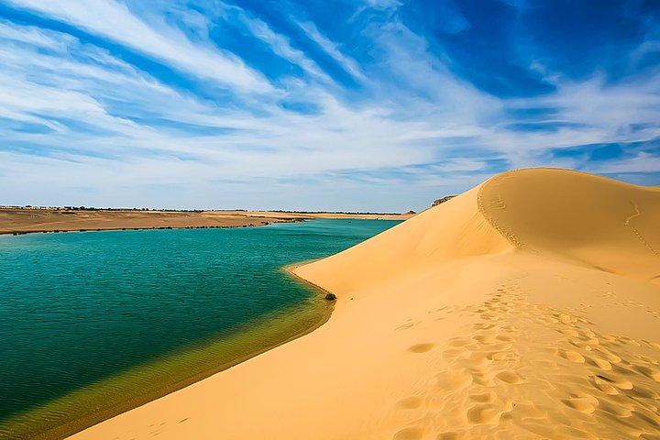
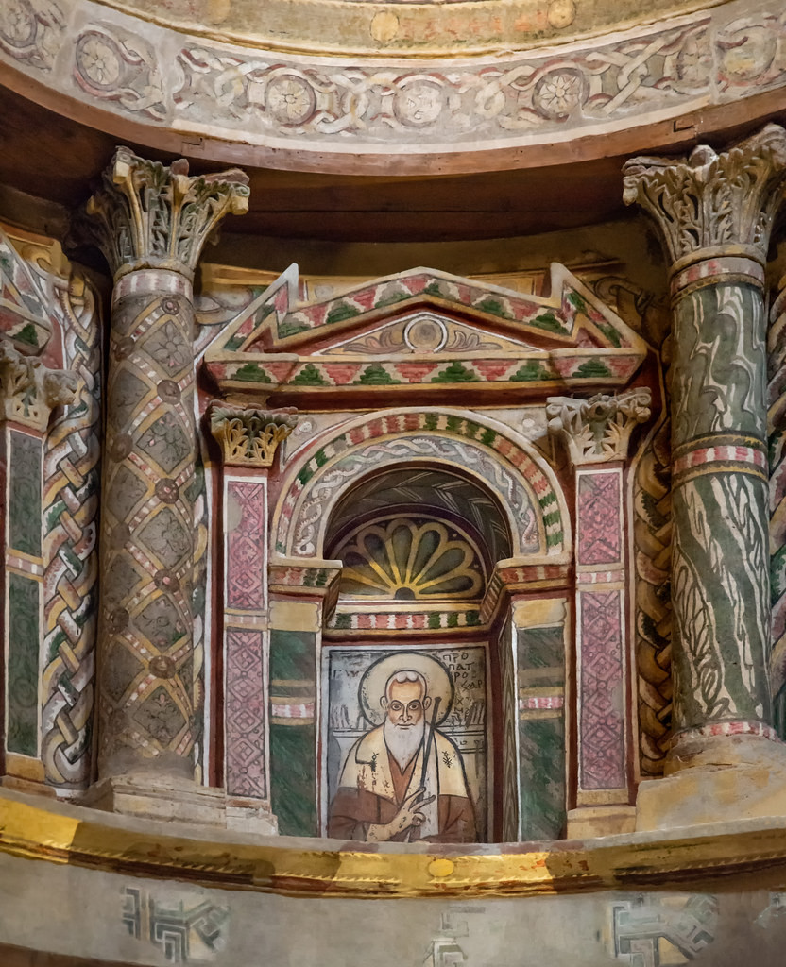
Egypt
The land of Wonders
#let_us_explore_Egypt

Slide 2
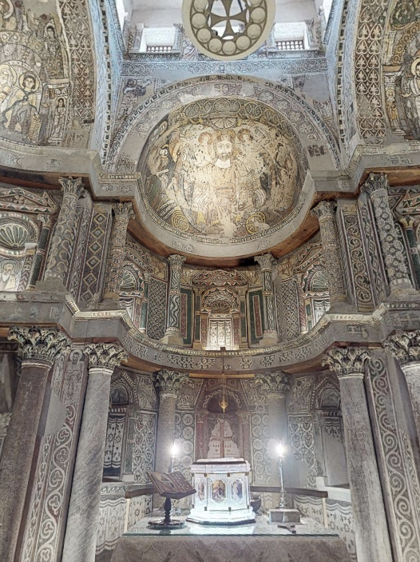
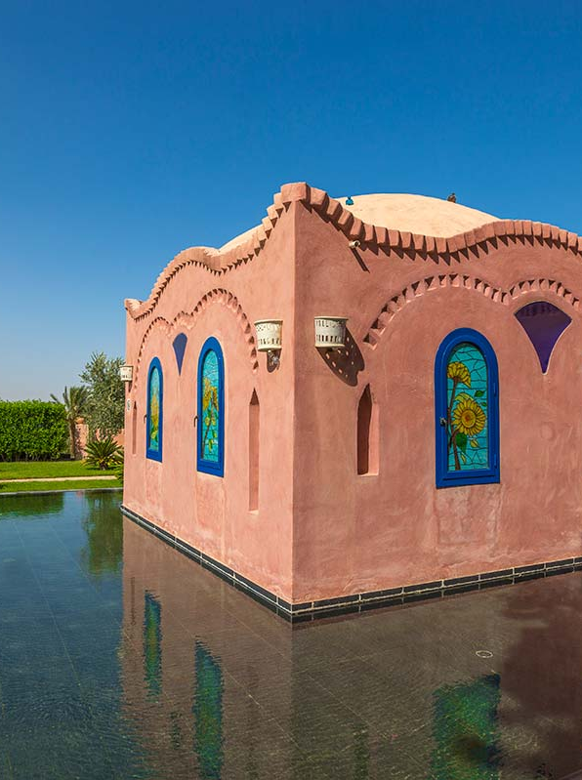
Explore Egypt from your home
#let_us_explore_Egypt
Plan the trip with no tickets or credits ..
Explore Egypt at your own pace

Slide 3


Slide 4


Slide 5
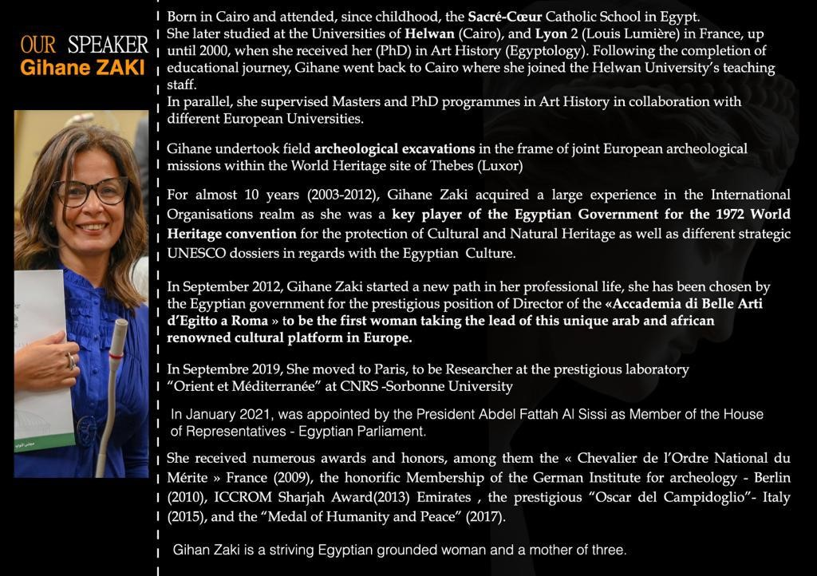

Slide 6


